Slide 1
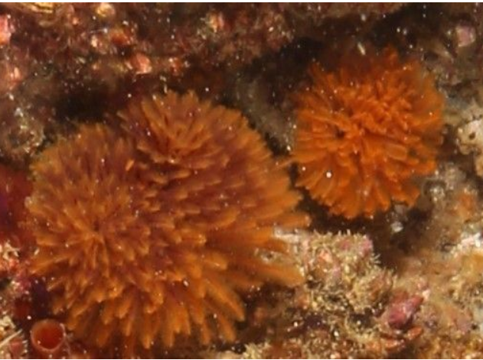
Eudistylia polymorpha
Feather Duster Worm

Slide 2
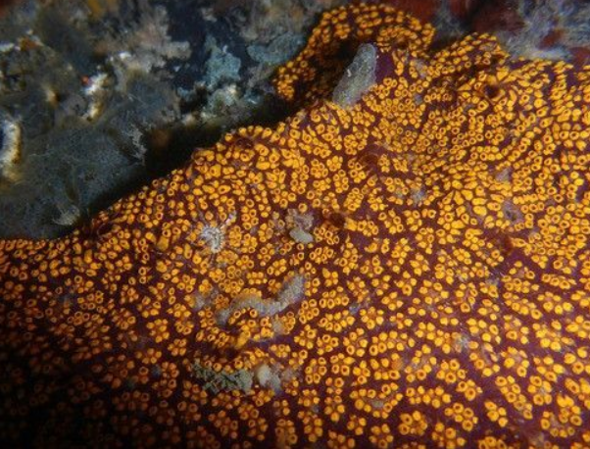
Botrylloides diegensis
Chain sea squirt

Slide 3
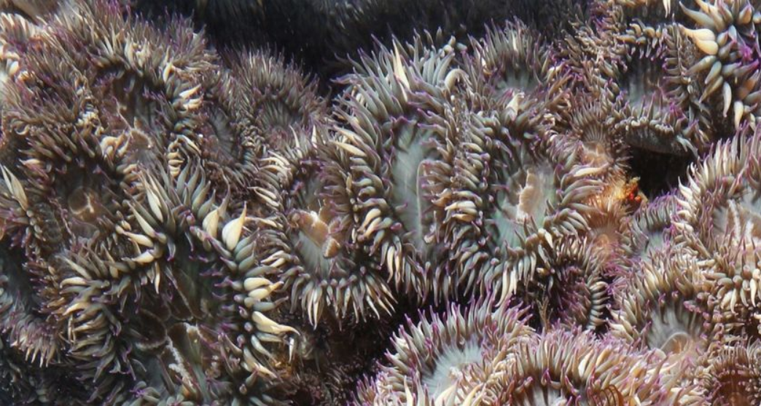
Anthopleura elegantissima
Aggregating anemone

Slide 4
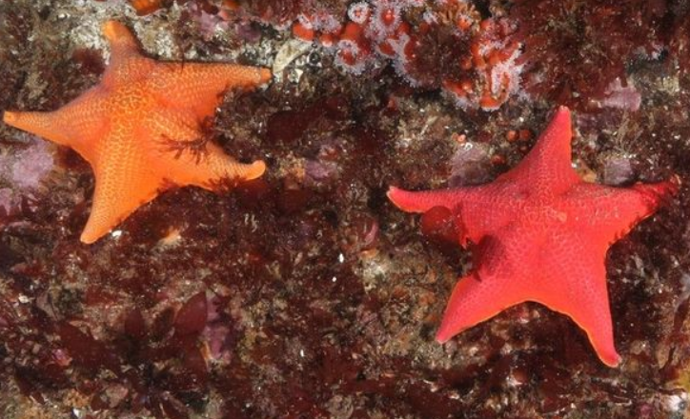
Patiria miniata
Bat star

Slide 5
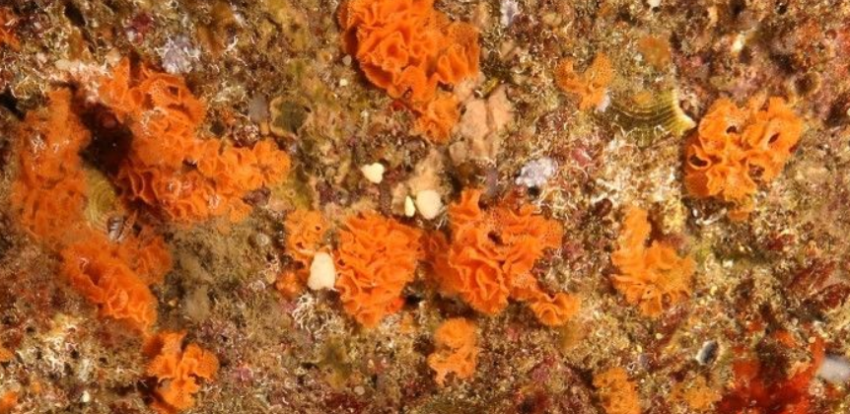
Phidolopora pacifica
Lattice-work bryozoan

Slide 6
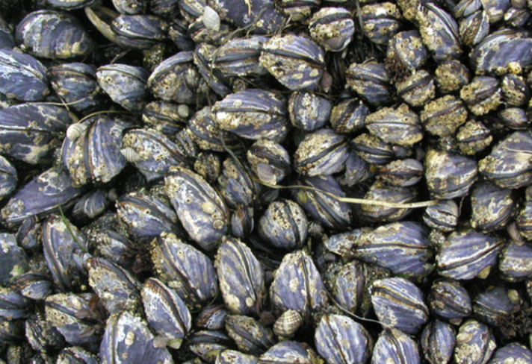
Mytilus californianus
California mussel

Slide 7
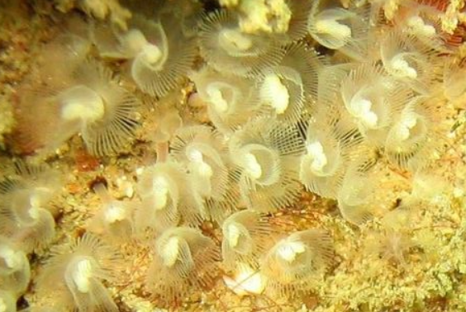
White phoronid

Slide 8
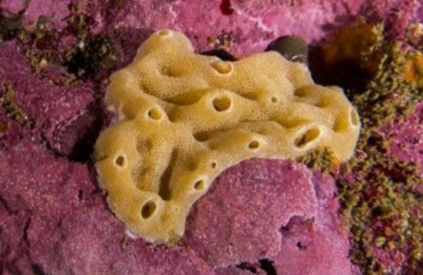
Leucandra losangelensis
Noodle sponge

Slide 9
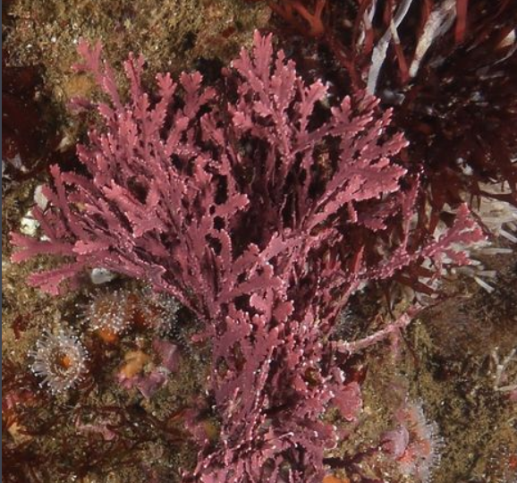
Calliarthron tuberculosum
Coralline red alga

Slide 10
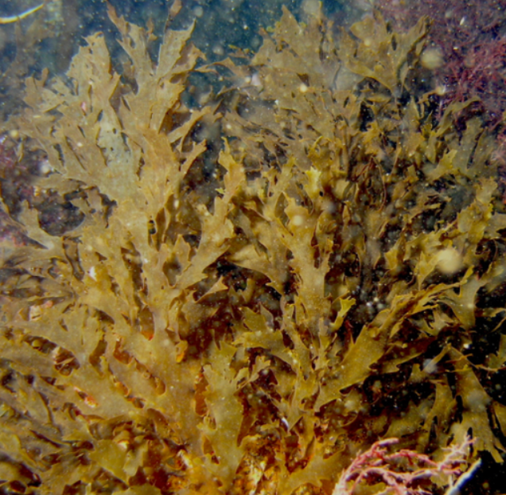
Dictyota binghamiae
Mermaid’s glove

Slide 11
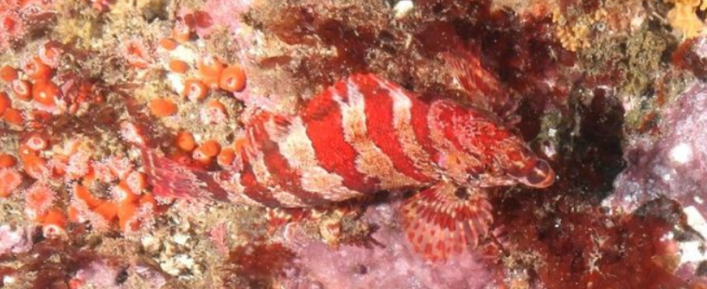
Oxylebius pictus
Painted greenling

Slide 12
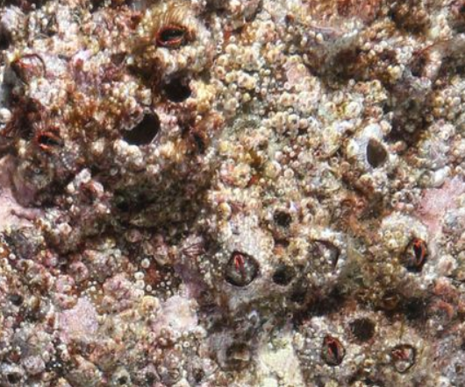
Megabalanus californicus
California barnacle

Slide 13
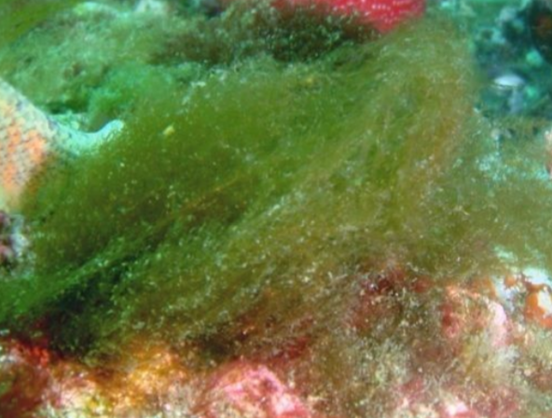
Filamentous green algae

